Slide 1
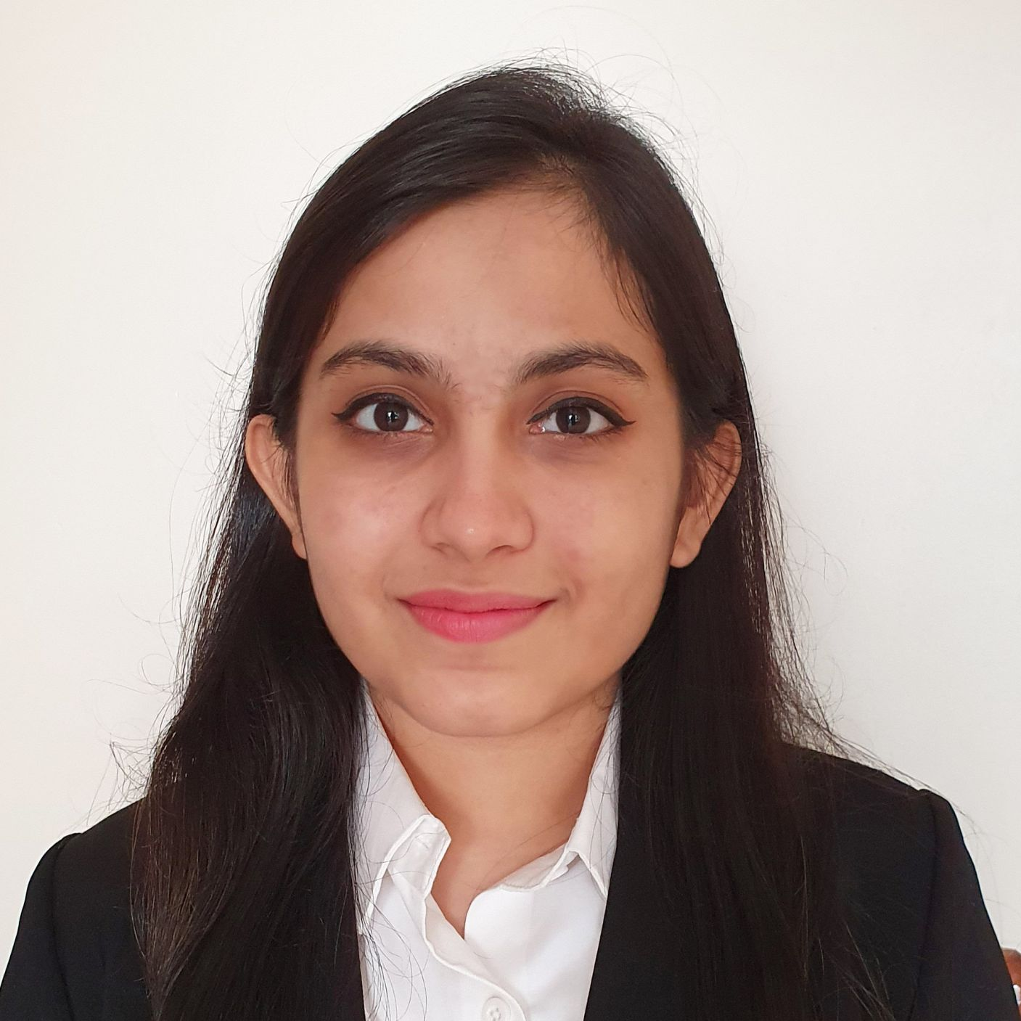



Bhargavi Sameep Kavalanekar
Analyst/Software Engineer
Bachelor of Engineering
Electronics and Communication : 2017 - 2021
Skills
Mumbai
Java 8 /J2EE | Java Basics, OOPS, Generics, Collections, Arrays, Loops, Stream API Junit, Mockito, Servlets
Spring core | IOC & Dependency Injection
Spring REST | REST controllers, Implementation of GET, POST, PUT & DELETE, Bean Validation & Exception Handling.
Spring Boot Microservices | Spring Boot Starters, annotations, Swagger API documents
Spring Cloud | Eureka, Netflix Hystrix, Netflix Zuul & Config Server
Angular | Components, Services, Modules, Routing, Forms & Validation, Testing using Jasmine & Karma
Database | MongoDB No Sql Basics My SQL Basics
UI Tech | HTML 5 & CSS 3,JavaScript, ES6 & TypeScript.
Tools | Git, Postman, Maven, IDE
Add On skills | Communications, Team management. Peer learning
bhargavi-sameep.kavalanekar@capgemini.com
+91 9004674742
A4
Full Stack Developer
Hands on experience in creating microservices with Spring boot, Spring Security, Spring Cloud API Gateway, Eureka server
Hands on experience in creating single page web application
Java Microservice Development knowledge using Spring boot and spring cloud framework on an intermediate level.
Team player who communicates effectively and works well with others to improve work output.
Eager to improve myself by learning new technologies and increasing my overall skills.
Coupons and Deals Finder Application
Completed end to end Coupons and Deal case study using Java Full Stack with Angular along with JWT authentication.
Implemented Multiple Micro services using Spring Boot and Spring Cloud and connecting them via a Discovery Server i.e. Eureka. Including routing using Netflix Zuul as a API Gateway.
Frontend with Angular 12, using Angular CLI for creating a user-friendly UI.
Backend with Mongo Compass.
Completed the i-Transform Java Full Stack Angular training
Check out my work on GitHub & Video Profile

